Slide 1

BUNDELKHNAND UNIVERSITY JHANSI
Dept. of Mathematical Science & Computer Application
SESSION 2018-2019
PRESENTED BY:-
MAHIPAL PATEL
LUCKY TOLANI
KHITIZ SWARNKAR
KUNAL GANDHI
MAJOR PROJECT ON:- CLIMBER: THE ADVENTURE GAME

Slide 2
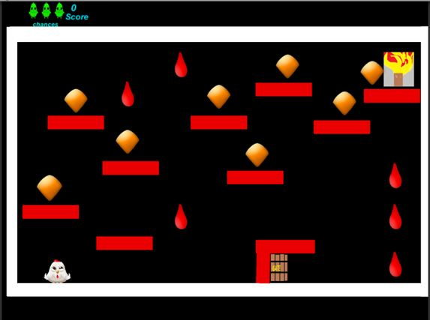
CLIMBER
( ADVENTURE GAME)

Slide 3
OBJECTIVES
To Provide Entertainment to the user.
To Increase Interest in Game Development.
To Release Some Stress of the user.

Slide 4
INTRODUCTION
‘Climber’ is a unity based 2d computer game developed for a purpose to provide fun for the user.
This is the single player game in which player has to start from the first level and player has his image in the game in form of a HEN .Player has to grab the egg’s embedded in the screen, the points are given on taking each egg, The compulsory part of game is that player has to take final trophy to open the gate which is the door of next difficult level. There are only three chances available to the user.

Slide 5
USER CHARACTERSTICS
User should know basic game play.
Educational level: Users should be comfortable with the English language.
Technical expertise: Should be comfortable using general purpose applications.

Slide 6
Processor: Pentium 233MHz (Recommended: Pentium 1GHz or greater) RAM: 64 MB RAM (Recommended: 128 MB RAM or Greater) Hard disk: 1.5GB of available hard disk space Other: Video adapter & monitor with Super VGA (800 600) Or higher resolution display with 256 Colors, DVD- ROM or CD-ROM drive; Keyboard and Mouse or compatible pointing device.
HARDWARE REQUIREMENTS

Slide 7
OPERATING SYSTEM: Windows 7/8/10 API: DirectX 9.0 or above VGA: Intel HD graphics or above(64Mb)
Software Requirements

Slide 8
Coding language
C# (Front end Language)
C# is a modern, general-purpose, object-oriented programming language developed by Microsoft and approved by European Computer Manufacturers Association (ECMA) and International Standards Organization (ISO).
C# was developed by Anders Hejlsberg and his team during the development of .Net Framework.
C# is designed for Common Language Infrastructure (CLI), which consists of the executable code and runtime environment that allows use of various high-level languages on different computer platforms and architectures.

Slide 9
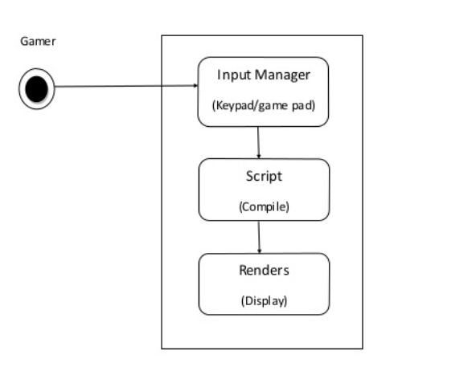
CONTEXT FREE DIAGRAM

Slide 10
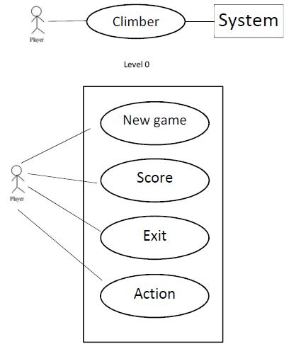
USE CASE DIAGRAM

Slide 11
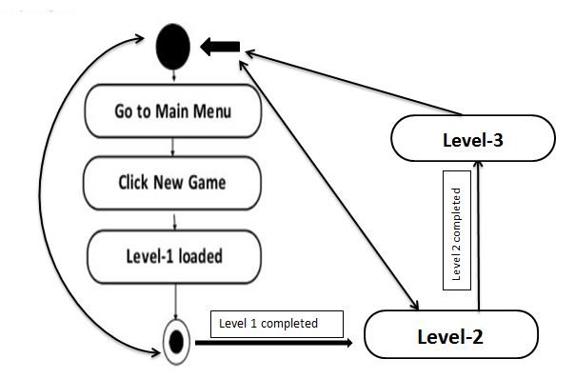
ACTIVITY DIAGRAM

Slide 12
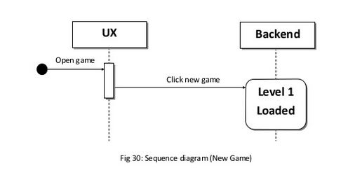
Sequence diagram

Slide 13
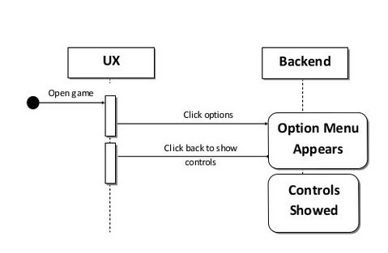
Sequence diagram

Slide 14
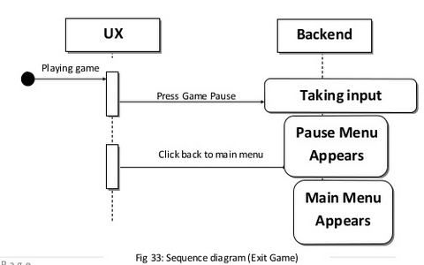
Sequence diagram

Slide 15

WELCOME WINDOW

Slide 16
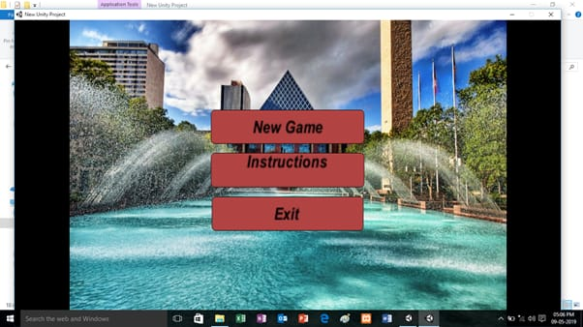
HOME WINDOW

Slide 17
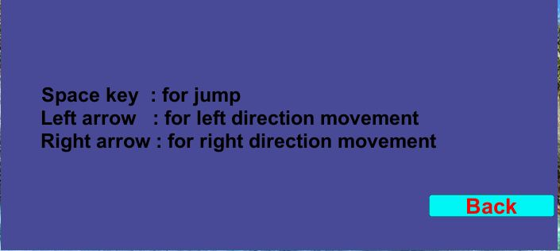

Options & exit

Slide 18

LEVEL 1

Slide 19
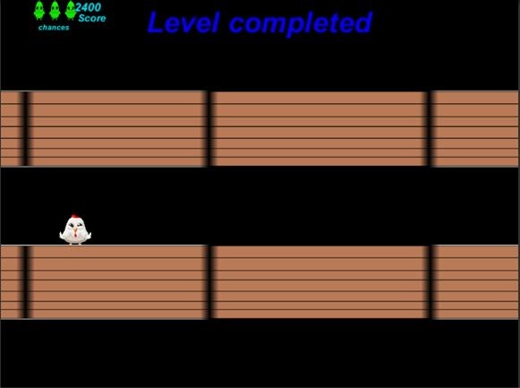
LEVEL COMPLETED WINDOW

Slide 20
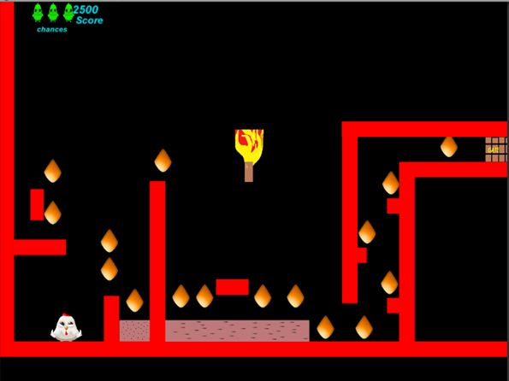
LEVEL 2

Slide 21
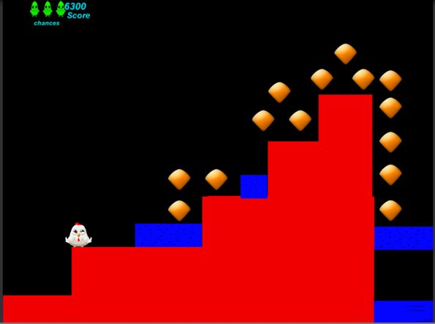
LEVEL 3

Slide 22
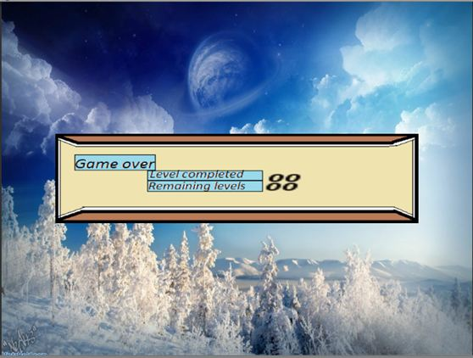
SCORE WINDOW

Slide 23
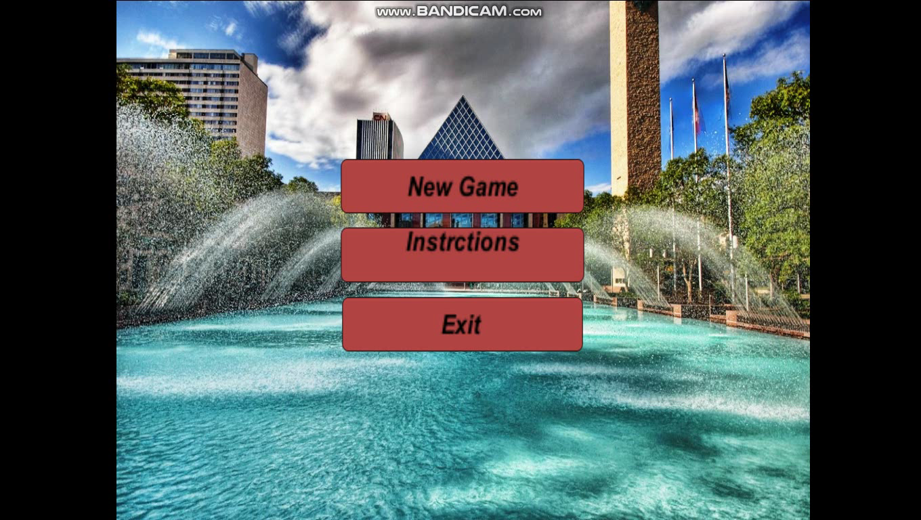
Short game play

Slide 24
conclusion
Game development is not an easy task to perform.
Game’s are very important part of our life.
Unity 3d is very good platform for development.

Slide 25
references
Websites
www.unity3d.com
www.wikipedia.com
www.youtube.com
www.unity.com
www.slideshare.com

Slide 26
Thank You…

